Slide 1
Pop Art

Slide 2
1. Life Story
I had a normal middle class childhood.

Slide 3
2. Life Story
My brother helped me collect celebrity images and autographs.

Slide 4
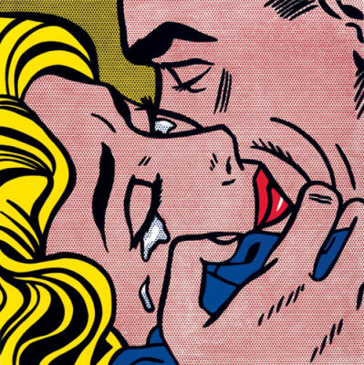
3. The Art

Slide 5
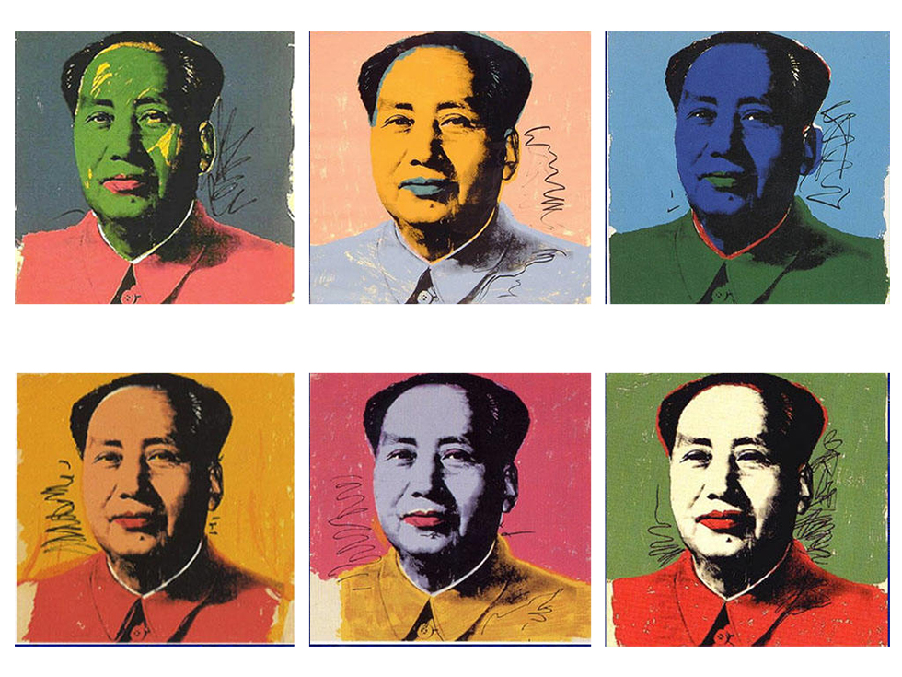
4. The Art

Slide 6
5. Life Story
I was born in Pittsburgh.

Slide 7
6. The Art
I made art about celebrities.

Slide 8
7. Life Story
I was a family man.

Slide 9
8. Life Story
My fourth grade teacher first noticed I was good at art.

Slide 10
9. Life Story
I graduated from high school early.

Slide 11
10. Life Story
I worked for a meteorologist as a hand model drawing symbols.

Slide 12
11. Life Story
I worked as a commercial artist.

Slide 13
12. Life Story
I attended Saturday art classes.

Slide 14
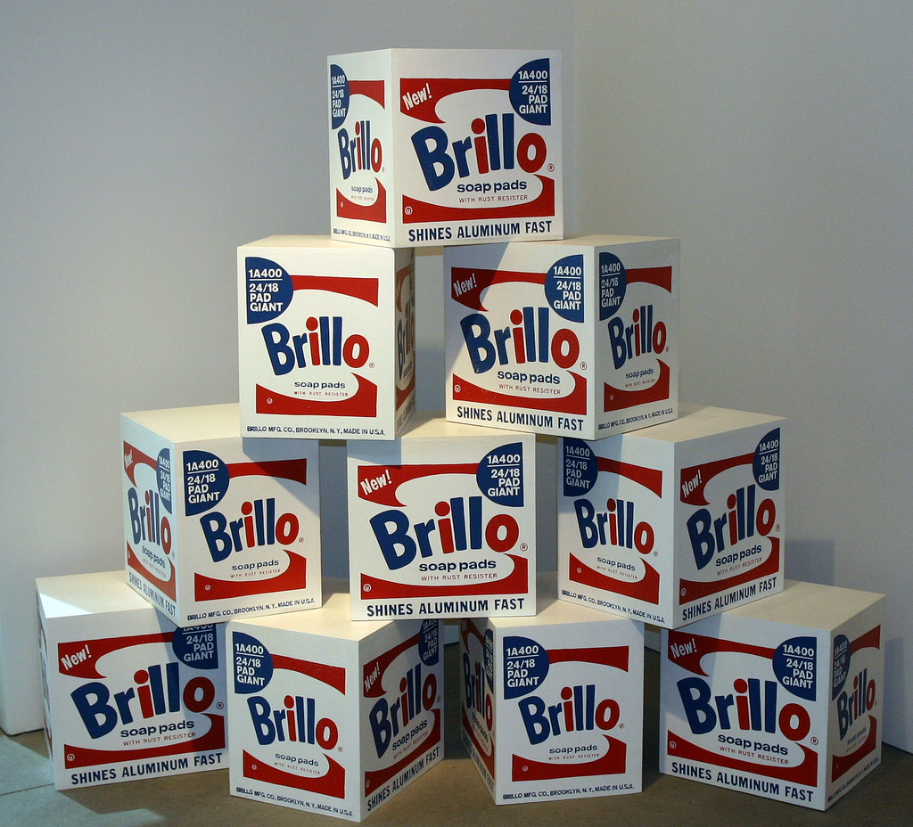
13. The Art

Slide 15
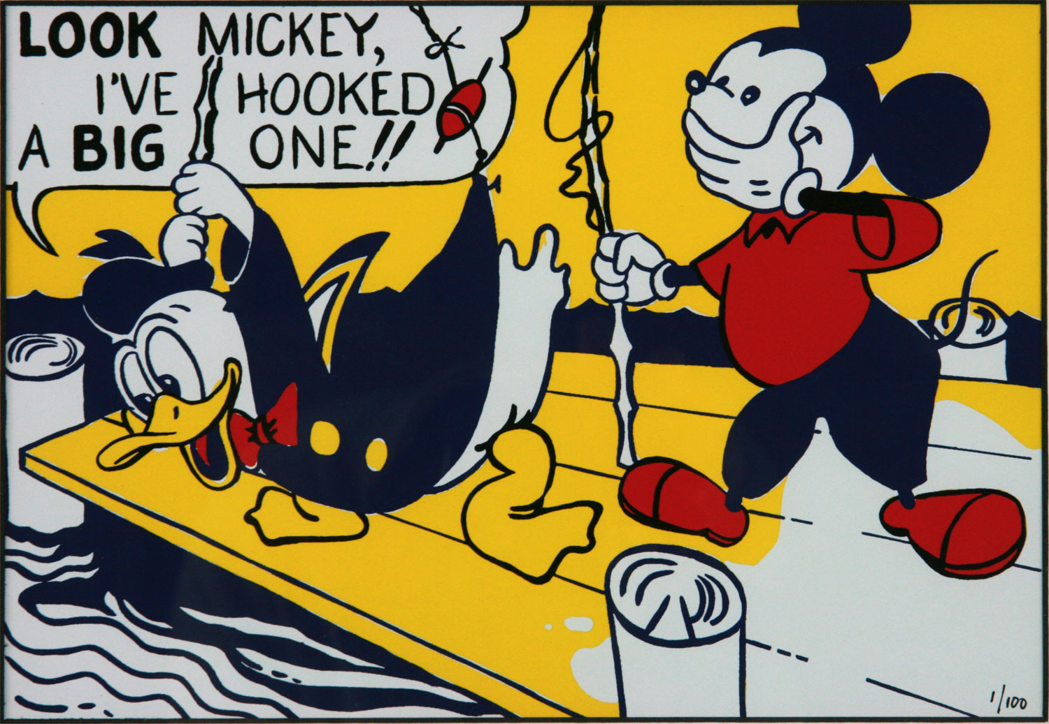
14. The Art

Slide 16
15. The Art
My work uses a lot of repetition.

Slide 17
16. The Art
I made video art to comment on life in the 1960s.

Slide 18
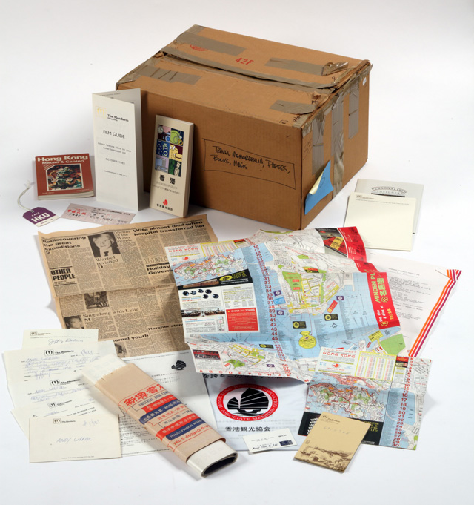
17. The Art

Slide 19
18. The Art
I made art about mass-produced items you can find at the store.

Slide 20
19. The Art
I like to make silk screen prints.

Slide 21
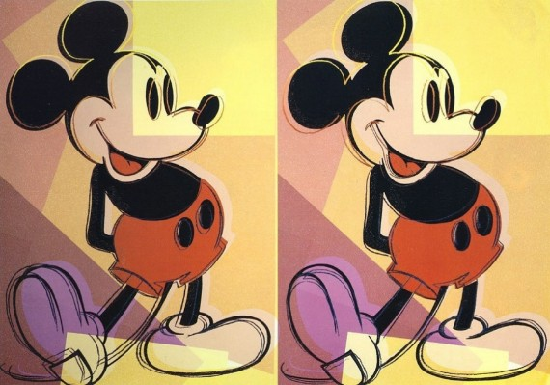
20. The Art

Slide 22
21. The Art
I use multiple unrealistic colors in many of my images.

Slide 23
22. The Art
I used paint to create my most famous artworks.

Slide 24
23. The Art
I created sculptures of Brillo Boxes.

Slide 25
24. Life Story
I set up window displays for retail stores.

Slide 26
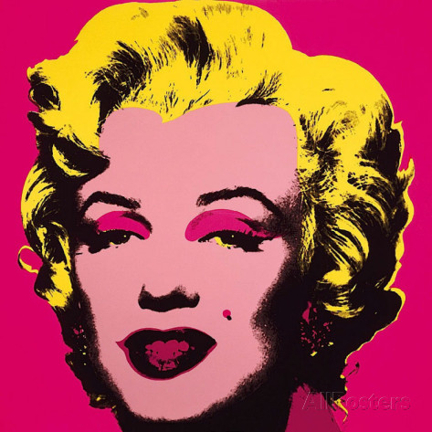
25. The Art

Slide 27
26. The Art
I copied anything that was not considered to be art at the time.

Slide 28
27. Life Story
I died of natural causes.

Slide 29
28. Life Story
I was shot by a friend who was angry that I would not let her have a say in the videos we filmed.

Slide 30
29. Life Story
They massaged my heart and I came back to life.

Slide 31
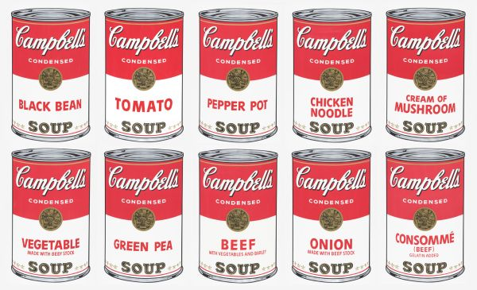
30. The Art

Slide 32
31. Life Story
I left my wealth to create a foundation that helps artists meet their goals.

Slide 33
32. The Art
My work features Ben Day dots.

Slide 34
33. Life Story
My sons were allowed to spend time with me in my studio.

Slide 35
34. Life Story
I paint because it’s fun.

Slide 36
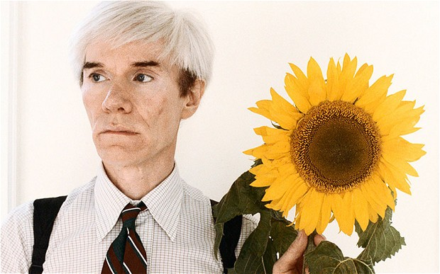
35. Life Story

Slide 37
36. Life Story
I served in WWII.

Slide 38
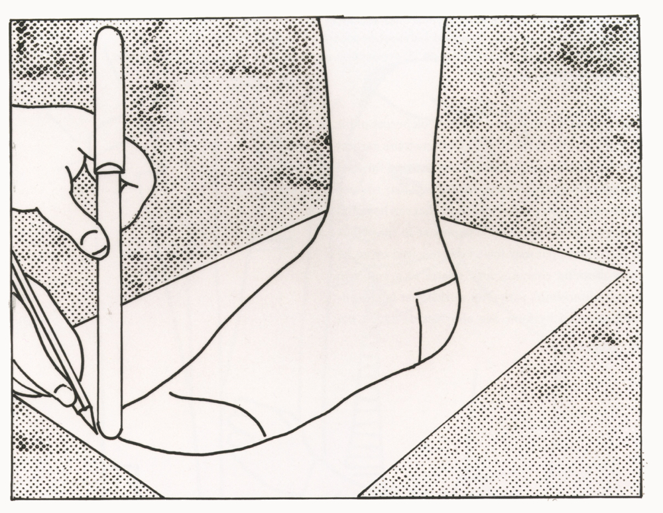
37. The Art

Slide 39
38. The Art
I made art about current events such as the JFK assassination.

Slide 40
39. Life Story
I went to a private school that did not have art classes.

Slide 41
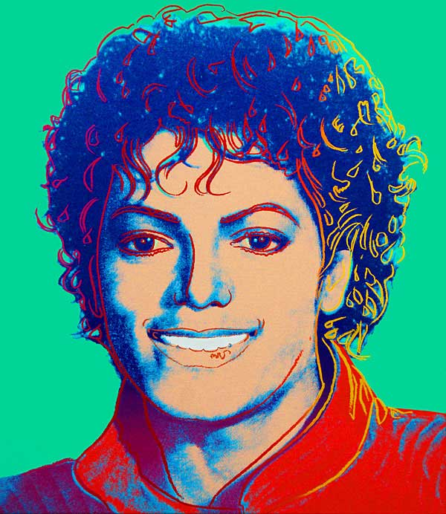
40. The Art

Slide 42
41. Life Story
I started making art at home as a teenager.

Slide 43
42. The Art
My work is not about feelings.

Slide 44
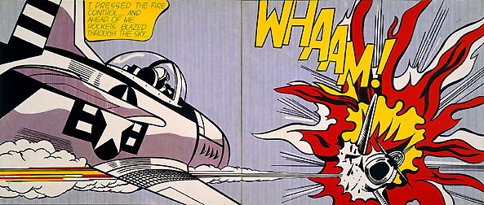
43. The Art

Slide 45
44. Life Story
I was once considered the worst artists in the United States.

Slide 46
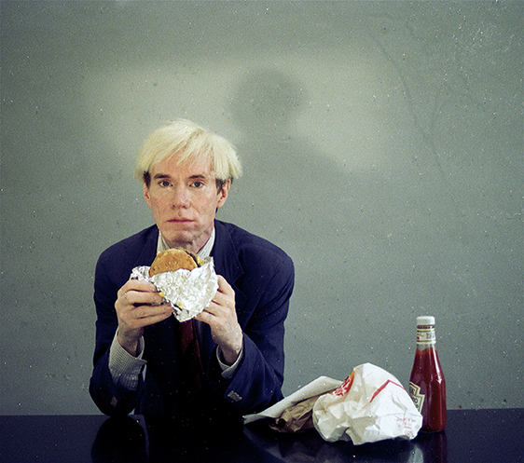
45. The Art

Slide 47
46. The Art
I liked to copy frames from comics.

Slide 48
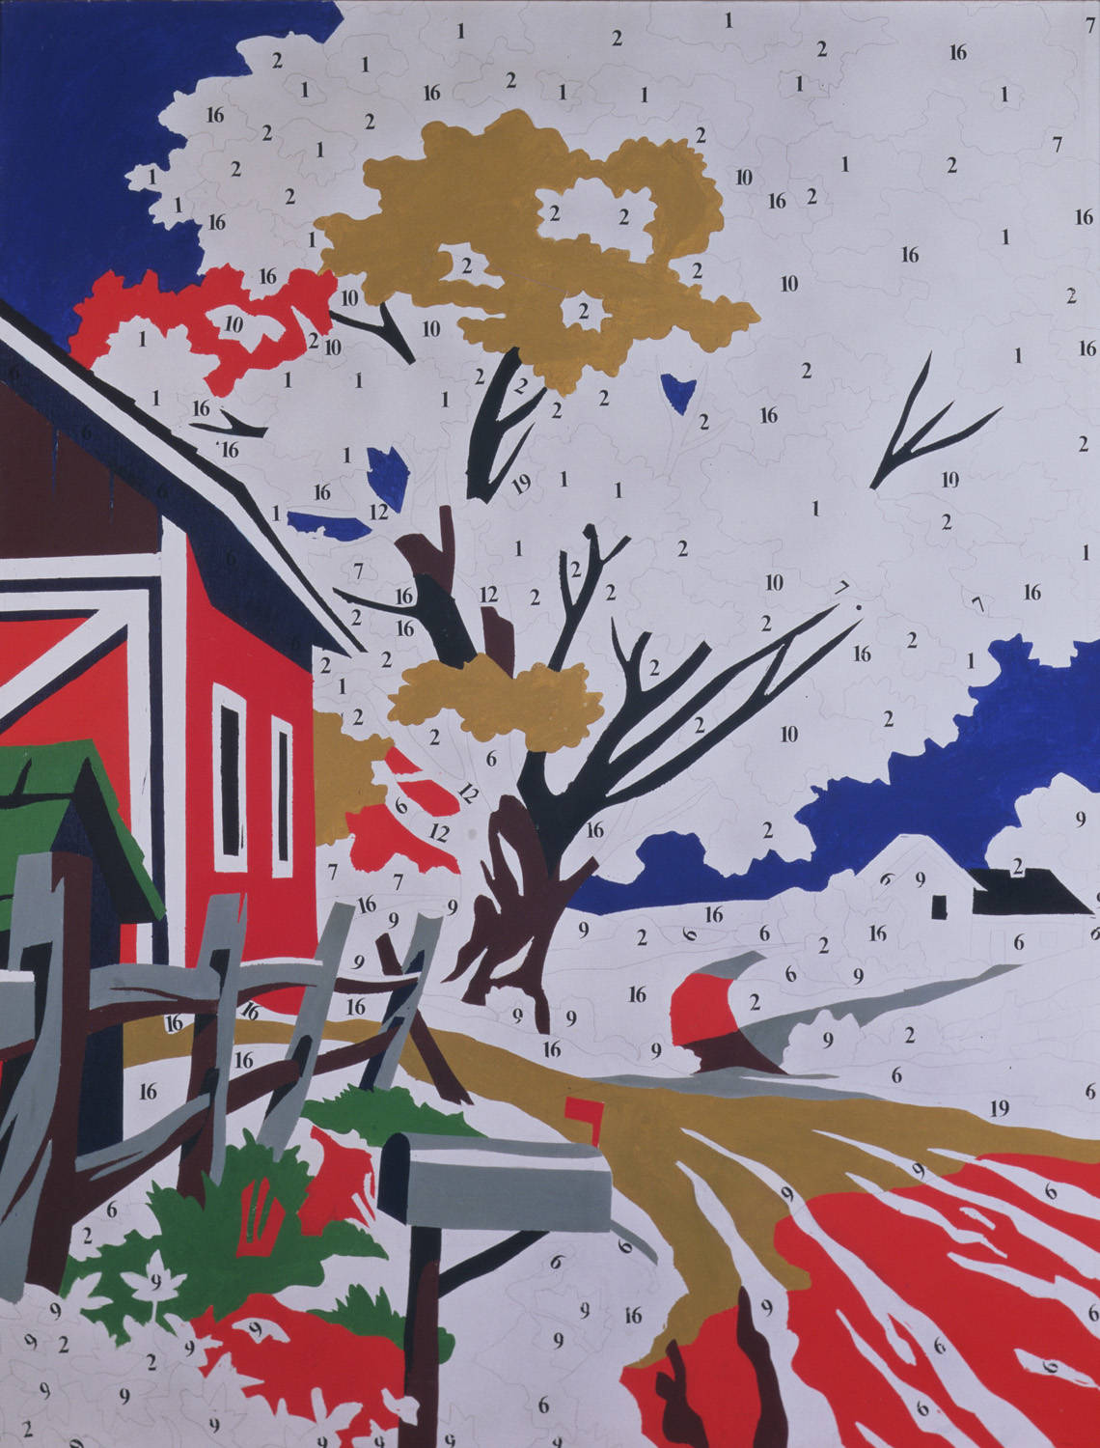
47. The Art

Slide 49
48. The Art
I had a sculpture garden on the roof of my studio.

Slide 50
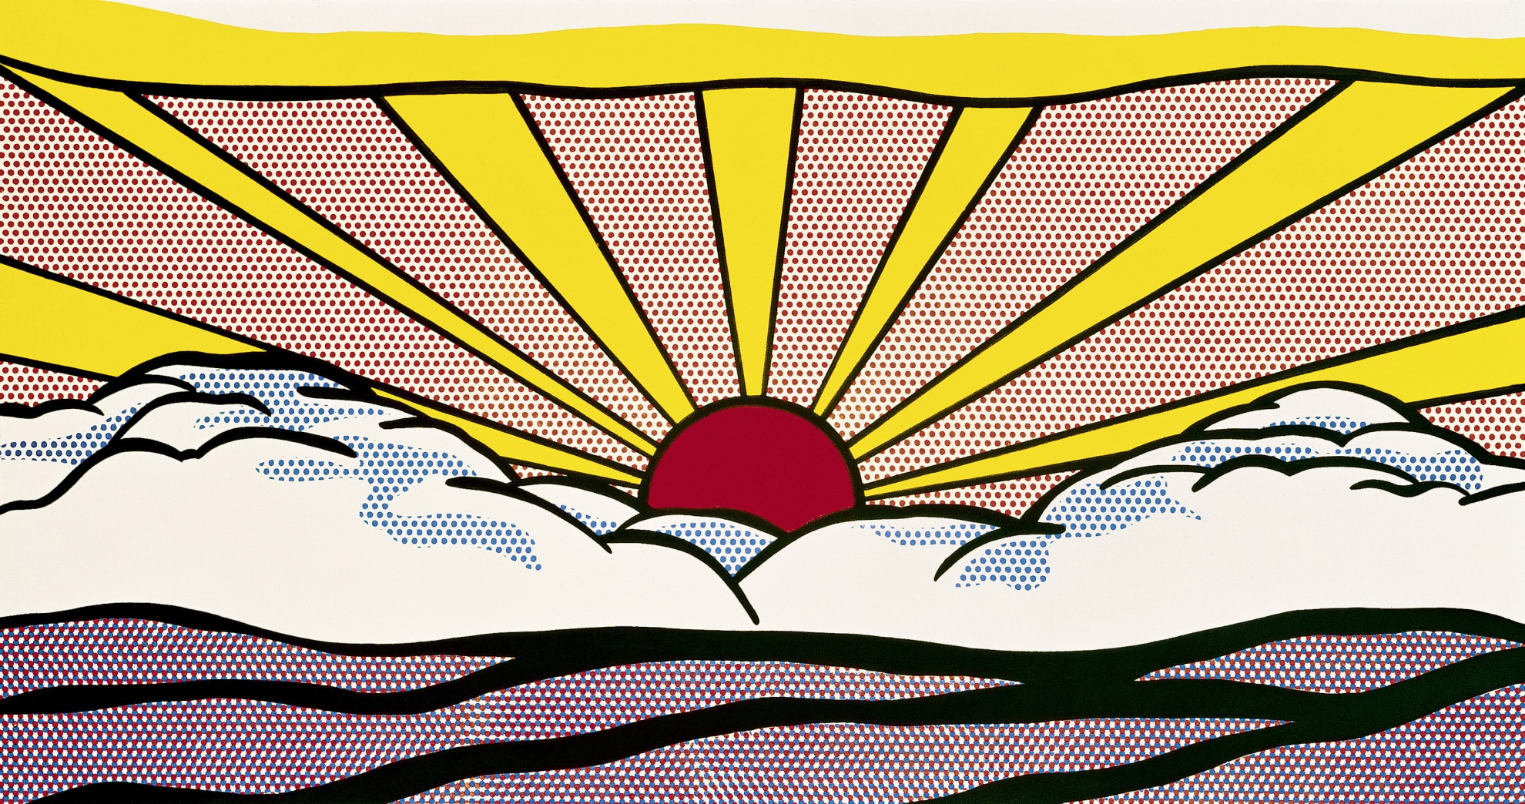
49. The Art

Slide 51
50. The Art
My first pop art painting was a copy of a bazooka gum wrapper.

Slide 52
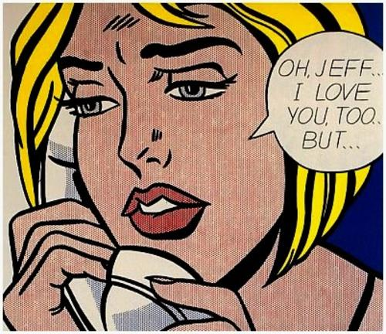
51. The Art

Slide 53
52. Life Story
I was sick as a kid.

Slide 54
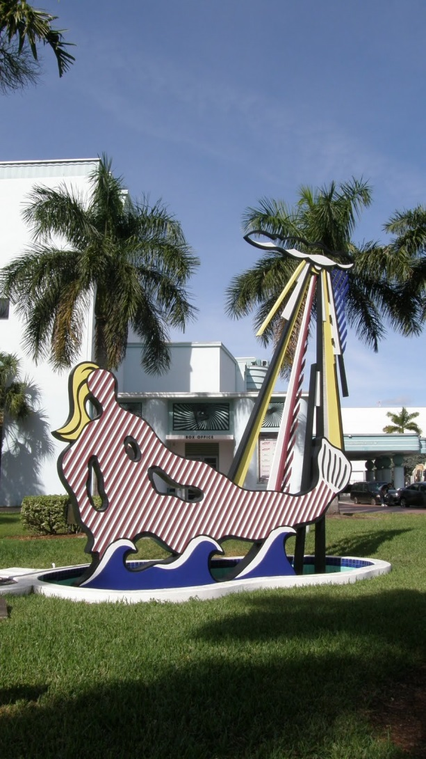
53. The Art

Slide 55
54.Life Story
My family sued New York Hospital after my death.

Slide 56
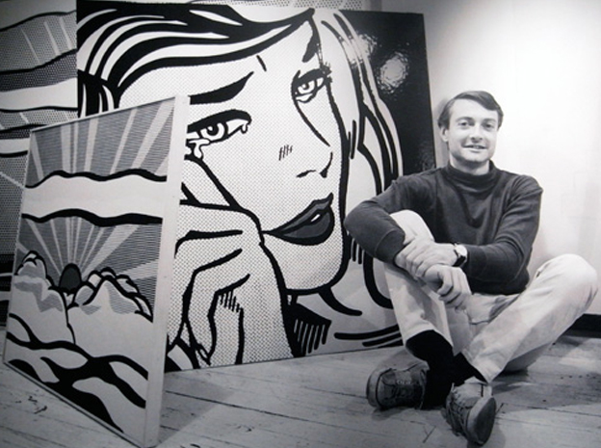
55. Life Story

Slide 57
56. The Art
I started out drip painting.

Slide 58
57. Life Story
I was born in New York.

Slide 59
58. The Art
I used a limited color pallet: Primary Colors and Black and White

Slide 60
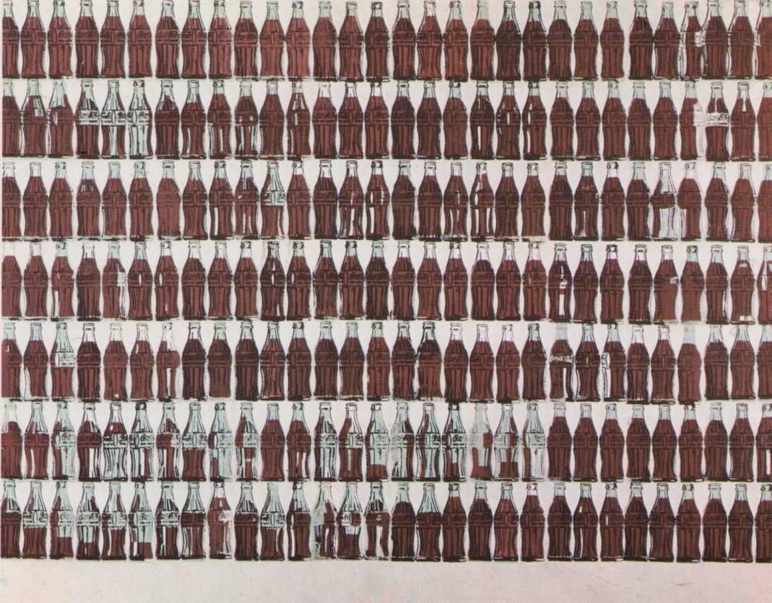
59. The Art

Slide 61
60. Life Story
I liked art as a young person.

Slide 62
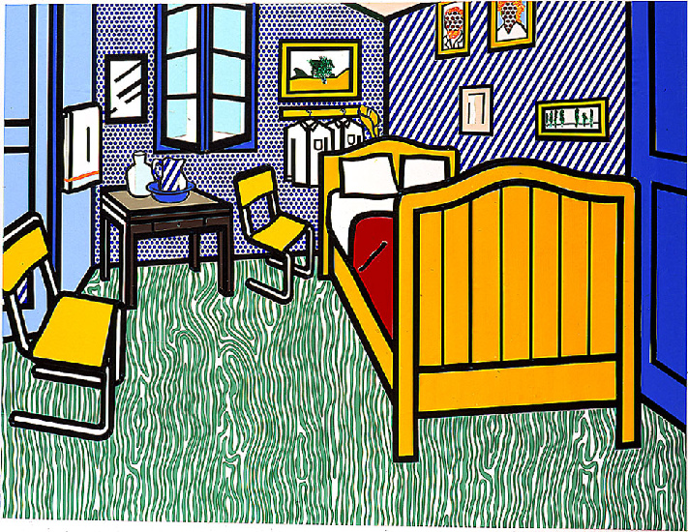
61. The Art

Slide 63
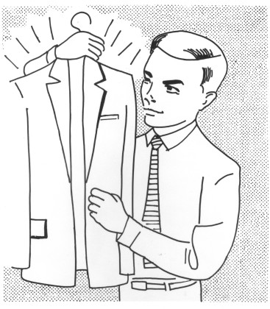
62. The Art

Slide 64
63. Life Story
I called my studio “The Factory.”

Slide 65
64. Life Story
My parents are from Czechoslovakia.

